Slide 1
XYZ Ads Airing Report Analysis
By: rajat panwan

Slide 2
Project Description:
The project is based on a dataset of TV Ad Airings for some brands in the Automobile category. The aim of the project is to analyze the data and answer the given questions. The dataset includes various features like the network through which Ads are airing, the type of network like Cable/Broadcast, show name on which Ads got aired, Dayparts, Time zone, the time & date at which Ads got aired, Pod Position, duration for which Ads aired on screen, equivalent sales &, total amount spent on Ads aired. We will be analyzing this data to understand the different brands' share in TV airings, the change in brand share from Q1 to Q4 in 2021, conducting competitive analysis for the brands, and suggesting advertisement strategies for the brands.

Slide 3
Approach:
The approach to this project is to first clean the data and check for missing values. I then explored the dataset to understand the variables and their distribution. After that, I answered the given questions using different statistical techniques and visualizations. For example, I used descriptive statistics to analyze the variables and their relationship with each other. We will also use visualization techniques like bar graphs, pie charts, scatter plots, and heat maps to present our findings.

Slide 4
Tech-Stack Used:
The analysis was performed using Microsoft Excel. We used different Excel functions, such as COUNT, COUNTIFS, SUM, UNIQUE and AVERAGE to perform the analysis. We also used PIVOT TABLE, SLICER in Pivot Table, CHARTS and GRAPHS to visualize the data.

Slide 5
Insights:
Some of the insights we gained from the data are:
Based on available data, It seems that Maruti Suzuki is the most showed brand in TV airings followed by Mahindra & Mahindra and Honda. The least is Toyota. I would suggest that Toyota, Hyundai and Tata should increase their TV airing numbers.
The share of various brands in TV airings changed from Q1 to Q4 in 2021. Tata Motors increased its share, while brands like Maruti, Honda and Toyota decreased their share.
Based on available data, It seems that brand Honda spends the least for sales of a car on average..
Based on the available data, Mahindra New Thar seems to be the most popular car in sales. Therefore, I would suggest Mahindra and Mahindra to focus on Mahindra New Thar in the digital ad campaign as well.
In terms of ad placement, the most effective pod position for the TV ads is 1. Therefore, I would suggest targeting this pod position for the digital ad campaign as well.

Slide 6
Result:
Through this project, we were able to gain insights into the advertising industry and how different brands advertise their products. We were also able to answer the given questions and provide recommendations for Mahindra and Mahindra's digital ad campaign. The project helped us understand the importance of data analysis and how it can help businesses make better decisions.

Slide 7


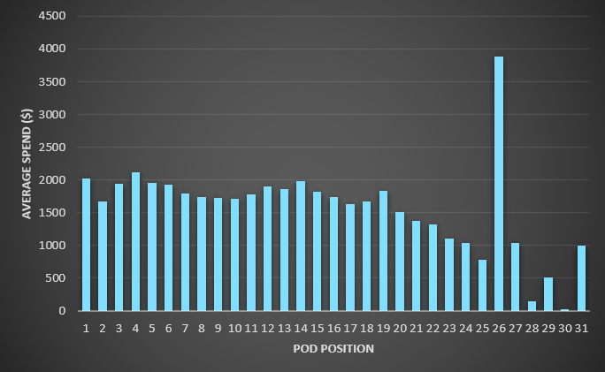
A. What is Pod Position? Does the Pod position number affect the amount spent on Ads for a specific period of time by a company?
With the help of correlation, here we can see that correlation between Pod Position and Amount Spend is very less so, we can say that pod position doesn’t effect the spend amount on Ads.
Also with the help of adjacent bar graph we can say that there isn’t any correlation between Average Spend and Pod Position. Although there is some trend in later parts, it seems decreasing but the value on 26 pod position is very high.

Slide 8
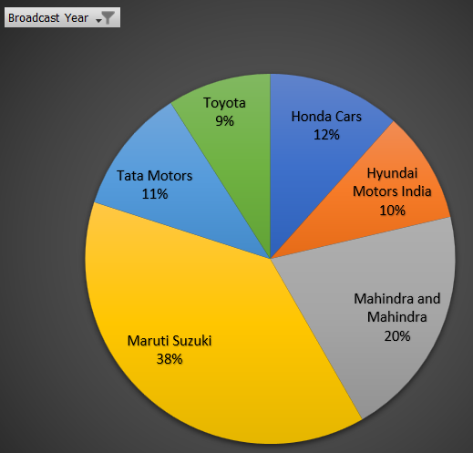
B. What is the share of various brands in TV airings and how has it changed from Q1 to Q4 in 2021?
Part-1
Based on available data, It seems that Maruti Suzuki is the most showed brand in TV airings followed by Mahindra & Mahindra and Honda. The least is Toyota. I would suggest that Toyota, Hyundai and Tata should increase their TV airing numbers.

Slide 9
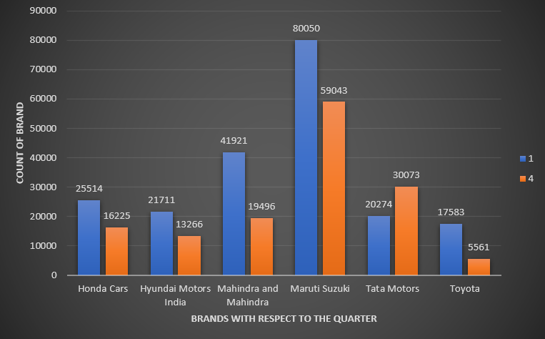
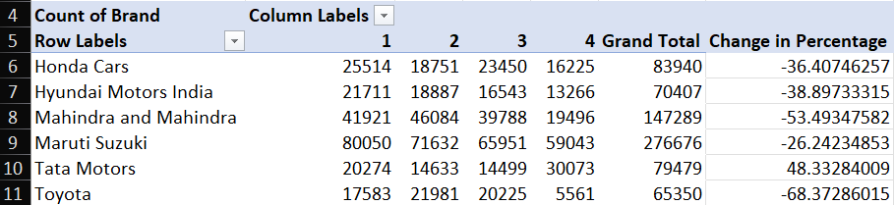
B. What is the share of various brands in TV airings and how has it changed from Q1 to Q4 in 2021?
Part-2
The share of various brands in TV airings changed from Q1 to Q4 in 2021. Tata Motors increased its share, while brands like Maruti, Honda and Toyota decreased their share.

Slide 10
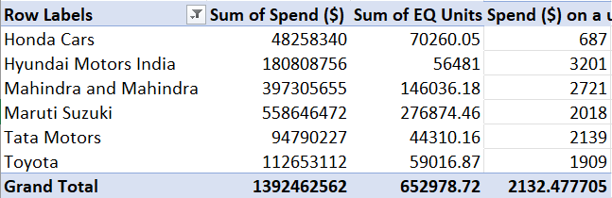
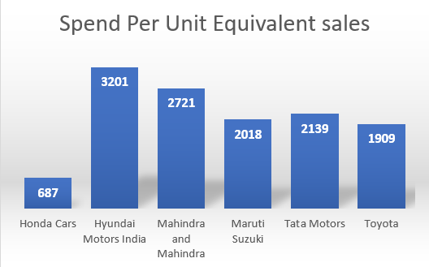
C. Conduct a competitive analysis for the brands and define advertisement strategy of different brands and how it differs across the brands.
Part-1
Based on available data, It seems that brand Honda spends the least for sales of a car on average. Hyundai, Mahindra & Mahindra and Tata Motors are the worst performing ad campaign because they spends the most to selling a car. Hyundai, Mahindra & Mahindra and Tata should try different strategy and combination to make it more effective.

Slide 11
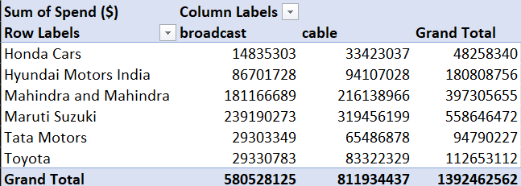
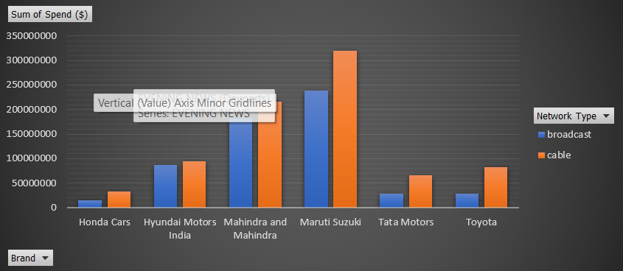
C. Conduct a competitive analysis for the brands and define advertisement strategy of different brands and how it differs across the brands.
Part-2
Based on available data, It seems that Honda runs the most successful ad campaign as it spend the less for a Equivalent sales. Honda’s maximum part of campaign is in the cable network type. I would suggest to other brand such as Hyundai and Mahindra & Mahindra to increase their cable budget.

Slide 12
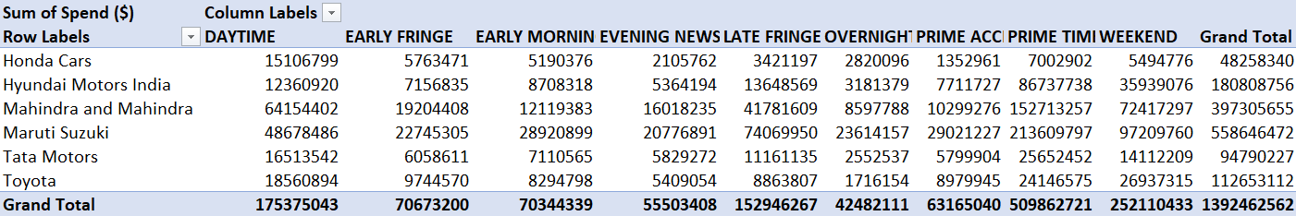
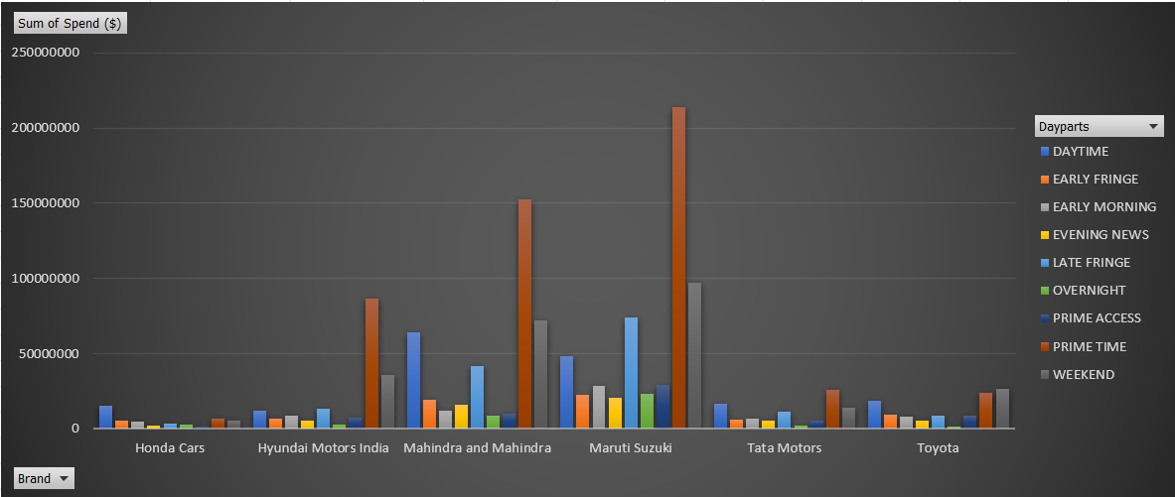
C. Conduct a competitive analysis for the brands and define advertisement strategy of different brands and how it differs across the brands.
Part-3
Based on available data, It seems that brand Honda spends the least for sales of a car on average and it’s maximum percentage of spend is on Daytime dayparts. I would suggest that Hyundai, Mahindra & Mahindra and Tata Motors should increase their Daytime daypart to increase their effectiveness.

Slide 13
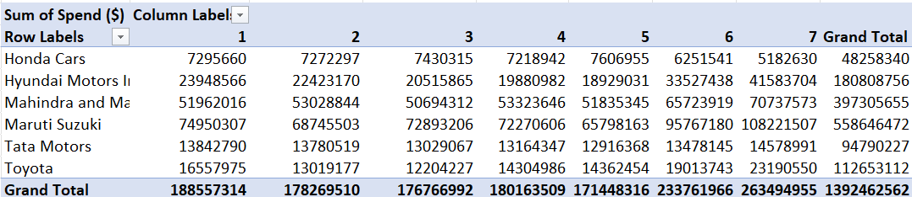
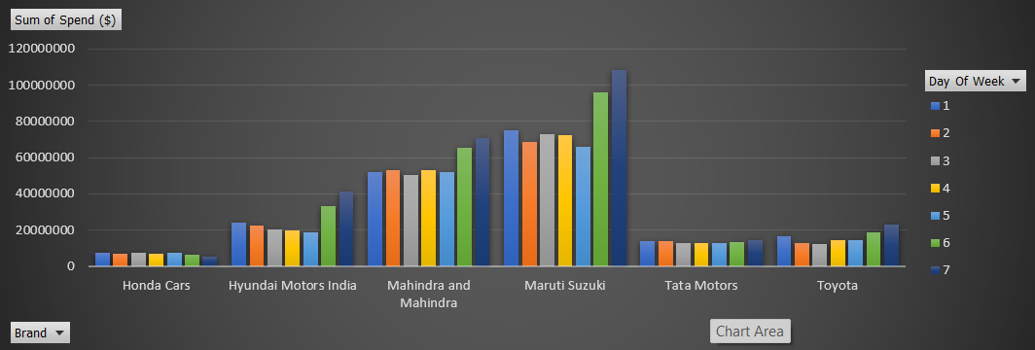
C. Conduct a competitive analysis for the brands and define advertisement strategy of different brands and how it differs across the brands.
Part-4
Based on available data, It seems that brand Honda spends the least for sales of a car on average and Honda’s spend throughout the week is same. I would suggest that Hyundai, Mahindra & Mahindra and Maruti should reduce their weekend spends.

Slide 14
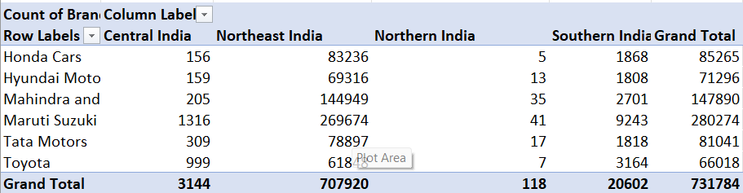
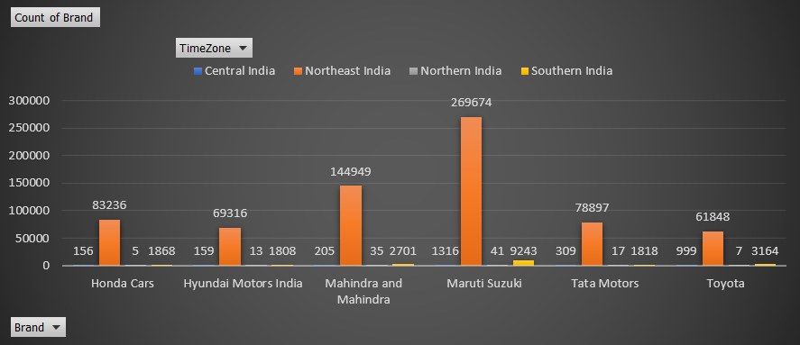
D. Mahindra and Mahindra wants to run a digital ad campaign to complement its existing TV ads in Q1 of 2022. Based on the data from 2021, suggest a media plan to the CMO of Mahindra and Mahindra. Which audience should they target?
Part-1
Based on the available data, Northeast India seems to be the target market for the ads. Therefore, I would suggest Mahindra and Mahindra to target this region in the digital ad campaign as well.

Slide 15
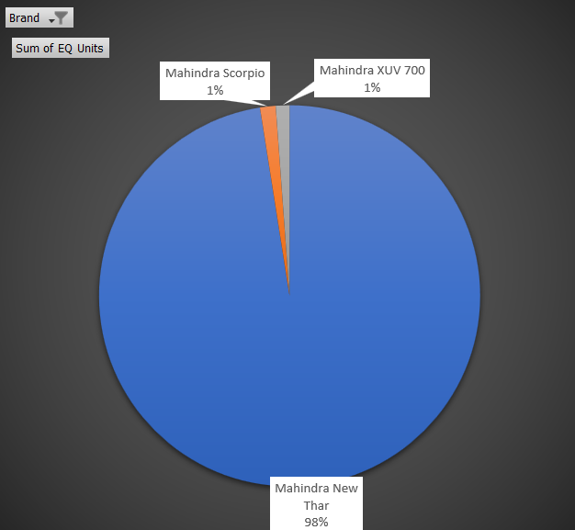
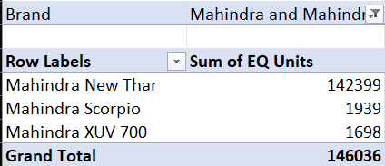
D. Mahindra and Mahindra wants to run a digital ad campaign to complement its existing TV ads in Q1 of 2022. Based on the data from 2021, suggest a media plan to the CMO of Mahindra and Mahindra. Which audience should they target?
Part-2
Based on the available data, Mahindra New Thar seems to be the most popular car in sales. Therefore, I would suggest Mahindra and Mahindra to focus on Mahindra New Thar in the digital ad campaign as well.

Slide 16
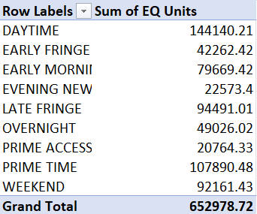
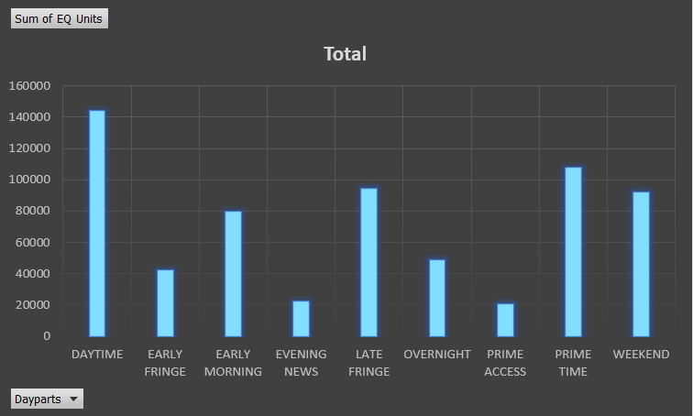
D. Mahindra and Mahindra wants to run a digital ad campaign to complement its existing TV ads in Q1 of 2022. Based on the data from 2021, suggest a media plan to the CMO of Mahindra and Mahindra. Which audience should they target?
Part-3
Based on the available data, the most effective dayparts for the TV ads are Prime Time, Daytime, and Late Fringe. Therefore, I would suggest targeting these dayparts for the digital ad campaign as well.

Slide 17
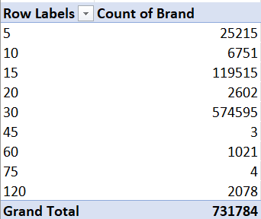
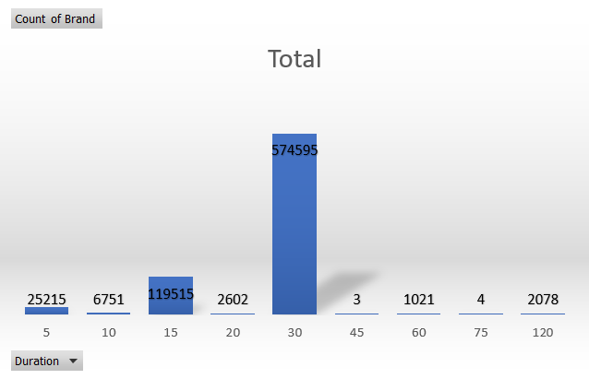
D. Mahindra and Mahindra wants to run a digital ad campaign to complement its existing TV ads in Q1 of 2022. Based on the data from 2021, suggest a media plan to the CMO of Mahindra and Mahindra. Which audience should they target?
Part-4
Based on the available data, the most popular ad duration for the TV ads is 30 seconds. Therefore, I would suggest Mahindra and Mahindra to target this duration for the digital ad campaign as well.

Slide 18
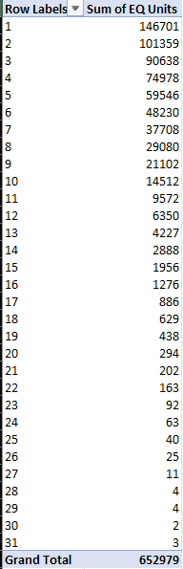
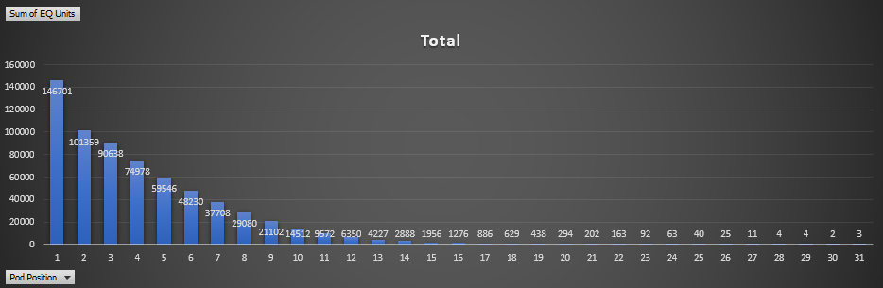
D. Mahindra and Mahindra wants to run a digital ad campaign to complement its existing TV ads in Q1 of 2022. Based on the data from 2021, suggest a media plan to the CMO of Mahindra and Mahindra. Which audience should they target?
Part-5
In terms of ad placement, the most effective pod position for the TV ads is 1. Therefore, I would suggest targeting this pod position for the digital ad campaign as well.

Slide 19
Drive Link
https://docs.google.com/spreadsheets/d/1-WuLmzQX-DvrLJT1cZYX3txnlO3j2naF/edit?usp=share_link&ouid=111299441641572124265&rtpof=true&sd=true

Slide 20
Thank You
Connect me on:
rajatpawan@gmail.com

